Slide 1
What is Web Services?
Advantages of Web services
Interoperability
Usability
Reusability
Deployability
Cost
Types of Web service testing
1. SOAP Web Services
2. REST Web Services

Slide 2
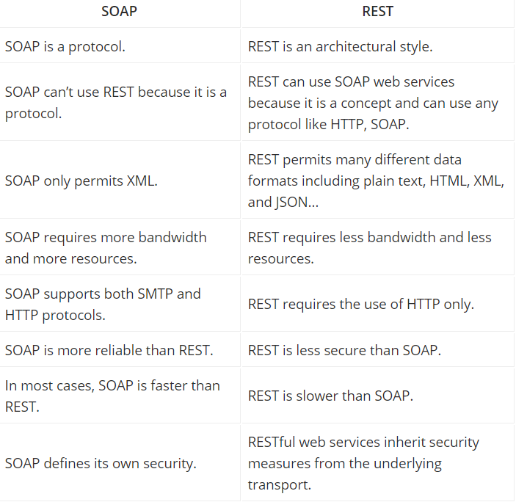

Slide 3
